Slide 1

]
AUTOML
CLASSIFIER

Slide 2

Automated Machine learning
Automated machine learning (AutoML)systems find the right algorithm and hyperparameters in a data driven way without any human intervention.

Slide 3
Auto ML Benefits
Auto ml allows the data scientist to extend his productivity without adding more members to the data science team.
Auto ml addresses the skills gap between the demand for data science talent and the availability of this talent.

Slide 4
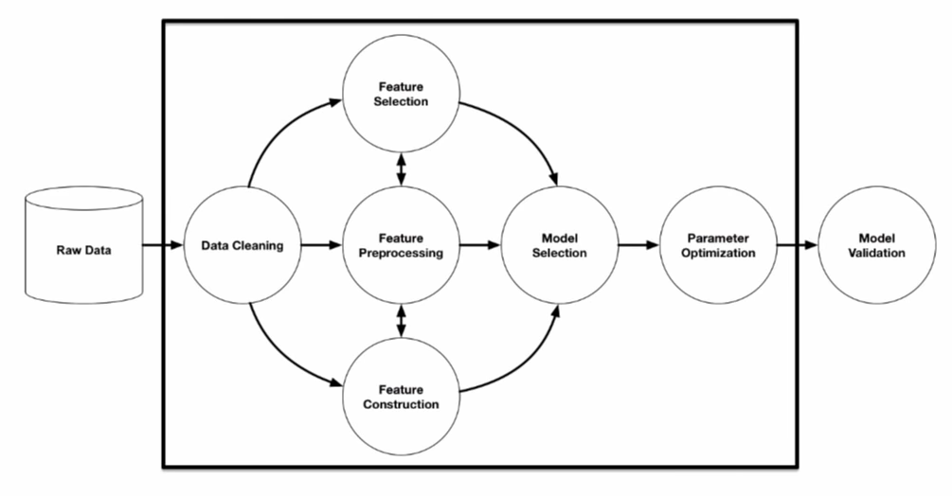
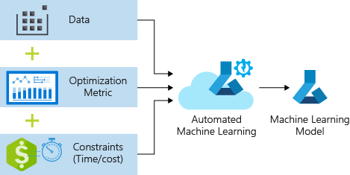
Auto ML aims to automate the entire ML workflow

Slide 5
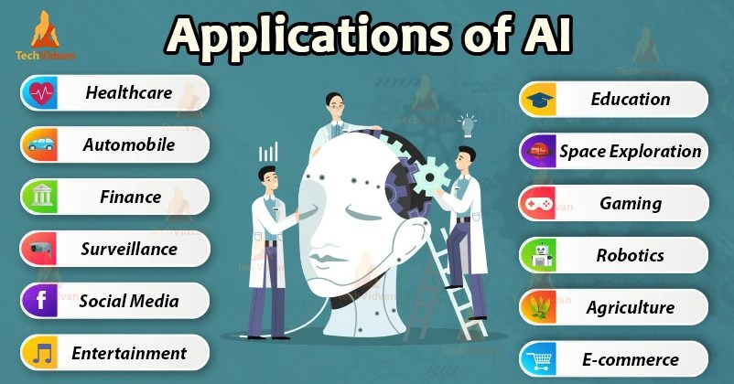

Slide 6
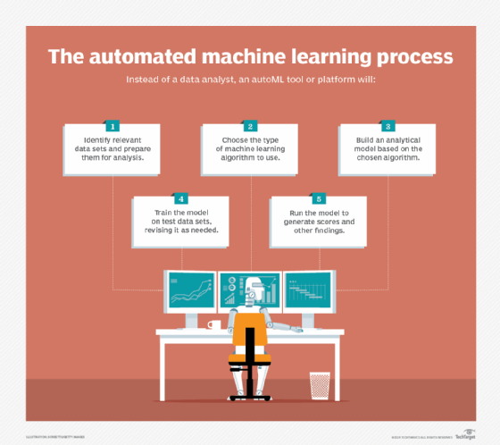
AUTOML PROCESS

Slide 7
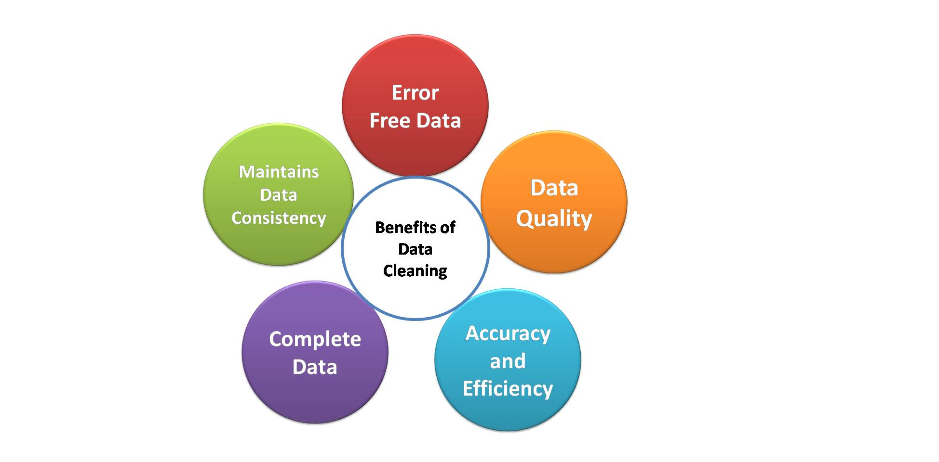

Benefits of Data Cleaning

Slide 8
Types of AutoML
Automated feature engineering
Automated model selection and hyperparameter tuning
Automated neural network architecture selection

Slide 9

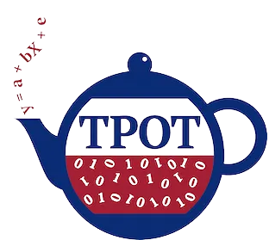



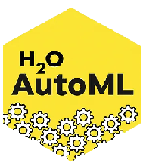
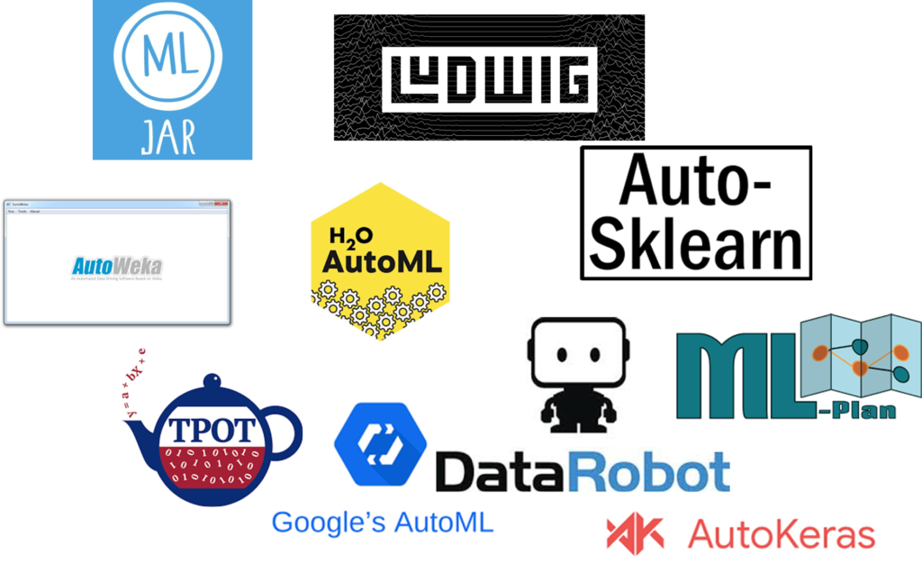

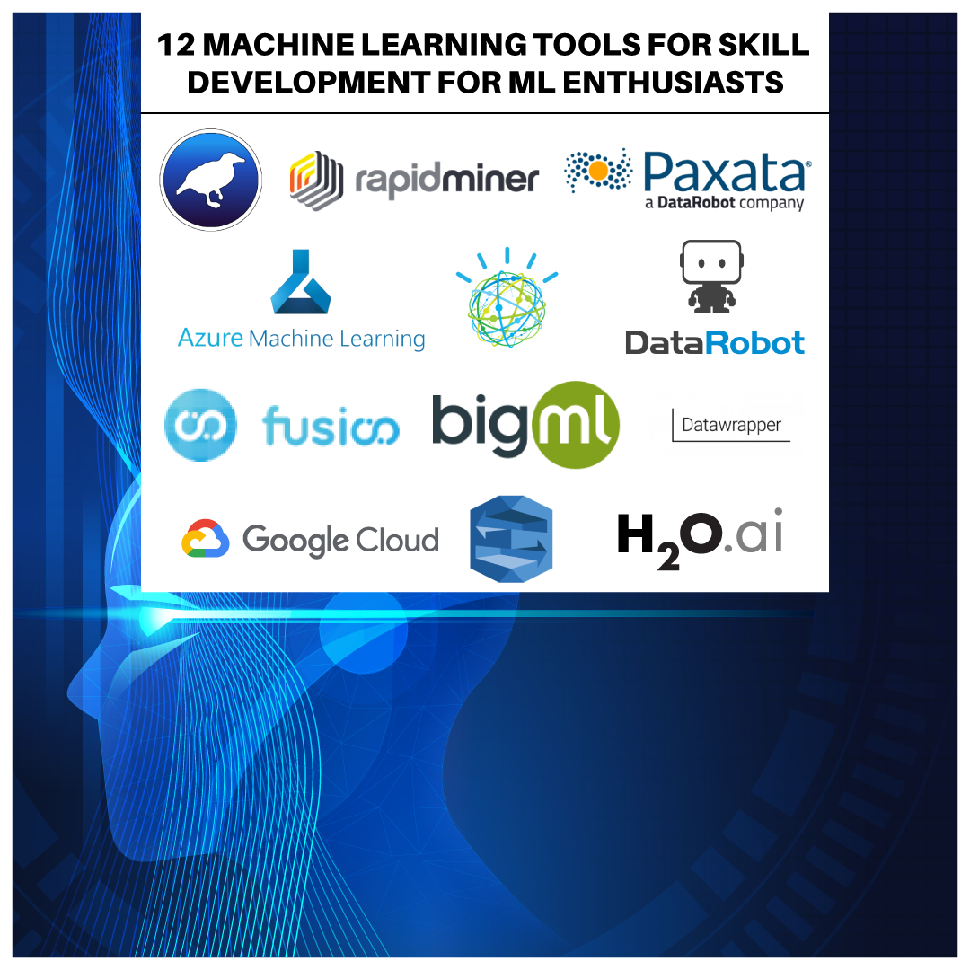
AUTOMATED ML TOOLS
PyCaret
Auto-Keras
Auto-SKLearn
DataRobot
MLBox
BigML
TPOT
RapidMiner
H2O
Splunk

